Slide 1
EETS 8390: data center network engineering
M. Scott Kingsley
CHAPTER 7: Network Virtualization

Slide 2
Chapter 7: Network Virtualization
Multiple tenants (customers) are hosted in some of the large cloud data center environments.
Not only are these tenants provided dedicated virtual machines, they can now also be provided a dedicated virtual network with many of the same features as a physically isolated network.
In this chapter, we describe multitenant cloud data centers and how they can take advantage of virtualized networks.

Slide 3
Chapter 7: Network Virtualization
We describe traditional methods of tunneling data through carrier networks and challenges that they present in virtualized data center networks.
Next, we provide some details behind Virtual Extensible LAN and Network Virtualization Generic Routing Encapsulation, which are the two most popular emerging standards for network virtualization in multitenant data centers.

Slide 4
Chapter 7: Network Virtualization
In addition, we provide an overview of tunneling locations and also provide details on how load distribution can be accomplished using these tunneling protocols

Slide 5
Chapter 7: Network Virtualization
Network virtualization is similar to server virtualization but instead of dividing up a physical server among several virtual machines, physical network resources are divided up among multiple virtual networks.
This is useful in applications such as multi-tenant data center environments where each tenant can be allocated multiple virtual machines as well as a virtual network connecting these virtual machines.

Slide 6
Chapter 7: Network Virtualization
One way to do this is to provide a special label within each frame that identifies the virtual network that it belongs to.
Labeling frames and forwarding data based on these labels is sometimes called network tunneling.
Tunneling has been used in telecom networks for some time, but these types of tunnels have limitations that make them less useful in virtualized data center networks.

Slide 7
Chapter 7: Network Virtualization
This chapter will provide a background on multi-tenant data center requirements along with a background on tunneling techniques used in telecom networks.
We will then describe two new industry standards for virtualized data center networks along with example use cases.
At the end of the chapter, we will discuss the various tunneling locations that can be used at the edge of the network along with how loads can be distributed through these tunnels.

Slide 8
Multitenant Environments
The goal of a multi-tenant public cloud data center is to make the customer experience much the same as if they were using their own private data center.
An additional goal of the cloud service provider is to have a flexible allocation of resources so they can quickly adapt to changing needs in order to reduce both capital expense and operating expense.

Slide 9
Multitenant Environments
For several years now, virtual machines have been used along with virtual switches to improve server utilization as we described in the last chapter.
Attention is now turning to the virtualization of networking resources in a way that maintains a private network experience.
Figure 7.1 shows a simplified view of a virtualized cloud data center including the physical servers and physical network components.

Slide 10
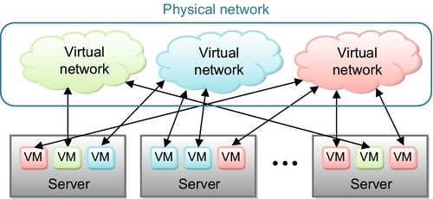
Multitenant Environments
FIGURE 7.1 Logical diagram of multitenant data center.

Slide 11
Multitenant Environments
In this example, the physical resources are divided up among three different tenants. The server administrator allocates virtual machine resources to each tenant that may reside on different servers across the network.
The network administrator also allocates virtual network resources to each tenant that interconnects the given tenant’s virtual machines.
The virtual machine network connections and virtual networks are isolated from each other using special headers that will be described further in this chapter.

Slide 12
Network Requirements
Virtualized networking places several requirements on the physical data center network.
In many cases, the virtual network is emulating a layer 2 Ethernet network, and all traffic sent or received from the VMs are layer 2 frames that must be tunneled through the data center network without the knowledge of the VMs.

Slide 13
Network Requirements
To do this, some entity in the server or attached to the server must encapsulate the layer 2 frame with a tunnel header on the transmit side and de-encapsulate the tunnel header on the receive side.
The tunnel label, along with other header information, is used to forward the packet through the layer 3 physical network.

Slide 14
Network Requirements
By using a unique tunnel value (or tag) for each virtual network, separation and security can be maintained between tenants.
The number of tunnel values increases dramatically for large data centers which may host thousands of tenants.

Slide 15
Network Requirements
Why not simply use the IEEE virtual local area network (VLAN) tag to identify unique tenants just as it is used to identify different virtual local area networks within a corporate network?
The reason for not using this tag is that corporate clients leasing public cloud services want to maintain their own VLAN information to separate different departments just as they would in their own data center.

Slide 16
Network Requirements
So the tunnel labels cannot share this tag due to conflicts with tenant VLAN information.
In addition, the VLAN tag only supports 4096 total values, restricting the maximum number of tenants that a cloud data center can support.

Slide 17
MAC Address Learning
Because most tunneling endpoints in the network appear as layer 2 ports to the host virtual machines, media access control (MAC) address learning must also be supported through these tunnels.
Before we get into the details of these tunneling protocols, let’s discuss how traditional layer 2 MAC address learning is accomplished.

Slide 18
MAC Address Learning
When a frame comes into a layer 2 switch, it contains both a destination MAC (DMAC) address and a source MAC (SMAC) address and, in most cases, also includes a VLAN tag.
The switch first compares the SMAC/VLAN pair against information in its local MAC address table. If no match is found, it adds this information to the MAC table along with the switch port on which the frame arrived.

Slide 19
MAC Address Learning
In other words, the switch has just learned the direction (port number) of a given MAC address based on the received SMAC.
Now any frames received on other ports with this MAC address and VLAN will be forwarded to this switch port. This process is called MAC address learning.

Slide 20
MAC Address Learning
But what happens if a frame arrives and has a DMAC/VLAN pair that is not currently in the MAC address table (called an unknown unicast address)?
In this case, the frame is flooded (broadcast) to all egress ports except the port it arrived on.
In this way, the frame should eventually arrive at its destination through the network.
Although flooding ties up network bandwidth, it is considered a rare enough event that it will not impact overall network performance.

Slide 21
MAC Address Learning
The assumption is that the device with the unknown destination address will eventually receive the frame and then send a packet back through the network from which its source address can be learned and added to the various switch address tables throughout the network.
This can happen fairly rapidly as many network transactions require some sort of response and protocols such as transmission control protocol (TCP) generate acknowledgment packets.

Slide 22
MAC Address Learning
These responses and acknowledgments can be sent back to the originator by using the SMAC in the received flooded frames.

Slide 23
Traditional Network Tunneling Protocols
These responses and acknowledgments can be sent back to the originator by using the SMAC in the received flooded frames.

Slide 24
Traditional Network Tunneling Protocols
Various tunneling protocols have been used for years in telecom networks.
In some cases, this has been driven by the need to isolate different customers as data is transported across Internet service provider networks.
In some cases, this has been driven by the need to simplify the forwarding process as data is transported across IP networks.

Slide 25
Traditional Network Tunneling Protocols
In this section, we will discuss both the Q-in-Q and multiprotocol label switching (MPLS) tunneling protocols that are used in carrier networks.
For completeness, we will also describe the VN-Tag that we introduced in the last chapter and how it could be used as a tunnel tag.
For each tunneling protocol, we will describe some properties that limit its usefulness for virtualized networking in large cloud data center networks.

Slide 26
Q-in-Q
Within a metropolitan area network, a given service provider may carry traffic for a corporate client that is routed between different facilities in different parts of the city.
These corporate clients want their networks to appear as one large corporate network even though they span multiple locations.
In order to tunnel client data through their networks, service providers can add a second, outer, VLAN tag as shown in Figure 7.2.

Slide 27
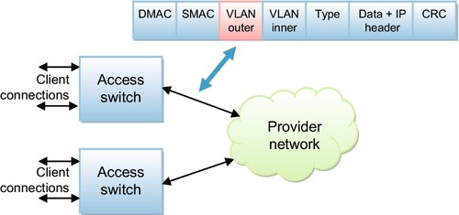
Q-in-Q
FIGURE 7.2 Q-in-Q forwarding and frame format

Slide 28
Q-in-Q
This was standardized by the IEEE as 802.1ad and is used in many provider networks today (sometimes called Provider Bridging).
Because this is an extension to the 802.1Q standard, it has become more commonly known as Q-in-Q.

Slide 29
Q-in-Q
In order to protect the inner VLAN tag for customer use, an outer VLAN tag is added where the 12-bit VLAN ID field is used to identify a given customer.
This tag is added and removed by the access switch and is used to isolate traffic in the provider network.
All forwarding and learning in the provider network can be done with the MAC addresses and outer VLAN tag.

Slide 30
Q-in-Q
In some cases, the VLAN 3-bit priority field is also used to assign class of service in the provider network.
The inner VLAN remains untouched and can be used by the customer for their own purposes. One problem with this technique is that the VLAN ID is limited to 12-bits which can contain only up to 4096 customer IDs.
Because of this, it is not very useful for tunneling in large cloud data center networks.

Slide 31
Q-in-Q
In fact, many large telecom service providers use techniques such as MPLS Transport Profile (MPLS-TP) instead; this will be described in more detail below.

Slide 32
MPLS
We briefly described MPLS in Chapter 2 as a way to reduce the frame processing requirements when forwarding frames through a TCP/IP network.
In the core of a TCP/IP network, a given switch/router must deal with multiple high bandwidth streams, and matching multiple frame header fields at these high rates can tax the available processing resources.

Slide 33
MPLS
Frame process rates are lower at the network edge where incoming traffic operates at lower overall bandwidth.
To take advantage of these conditions, MPLS was first proposed by Ipsilon Networks and then handed over to the Internet Engineering Task Force (IETF) in the late 1990s.
Figure 7.3 shows the MPLS label location in the frame header along with the switch and router components in an MPLS network.

Slide 34
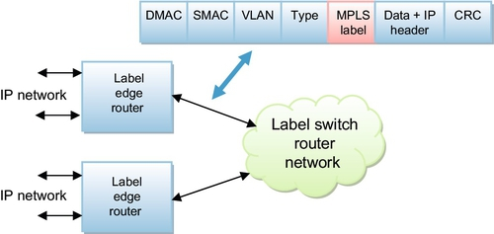
MPLS
FIGURE 7.3 MPLS forwarding and frame format

Slide 35
MPLS
The MPLS label edge router (LER) does the frame match heavy lifting and then adds an MPLS label to the frame as shown in Figure 7.3.
This is known as a label ‘push’ operation.
To simplify forwarding in the network core, the MPLS label switch routers (LSRs) only need to examine the MPLS label in order to forward the frame.
At the MPLS network egress, the label is removed in what is referred to as a ‘pop’ operation

Slide 36
MPLS
It’s possible to have a hierarchy of MPLS networks where one network is tunneled through another network by adding additional MPLS labels.
In these cases, a LSR may need to examine multiple labels and potentially perform multiple push and pop operations on a given frame,

Slide 37
MPLS
Since its introduction in the late 1990s, MPLS has found success in many areas. It is used in both IPv4 and IPv6 networks along with Virtual Private Networks (VPNs) and in carrier Ethernet networks using the MPLS-TP.
While many people have proposed using MPLS to provide network virtualization and tunneling in the cloud data center, it has not caught on yet and the industry seems to be instead migrating toward protocols such as Virtual Extensible LAN (VXLAN) and Network Virtualization Generic Routing Encapsulation (NVGRE) which are described in the next sections..

Slide 38
MPLS
There are several reasons for this.
Some people feel that MPLS is too complex and expensive to implement at the edge of a data center network.
In many cases, tunneling occurs within the vSwitch and hypervisor which both consume server processor cycles.
Any tunneling protocol implemented here must be as simple as possible in order to minimize CPU overhead.
In addition, multicast was not an important requirement for the original MPLS standard.
As we will describe in the VXLAN section of this chapter, multicast is an important feature for MAC learning in these layer 2 tunneled virtual networks.

Slide 39
VN-TAGS
Cisco and other companies originally proposed the VN-Tag protocol which became the basis for the Bridge Port Extension standard called IEEE 802.1qbh as we described in the last chapter.
Figure 7.4shows the VN-Tag location in a standard Ethernet frame and where it is used in the data center network.
The VN-Tag contains a virtual interface (VIF) identifier which can be used to forward frames to any type of VIF such as a virtual machine within a server.

Slide 40
VN-TAGS
A single physical network connection to the server using a VN-Tag capable network interface controller (NIC) may, therefore, utilize tags for multiple VIFs.

Slide 41
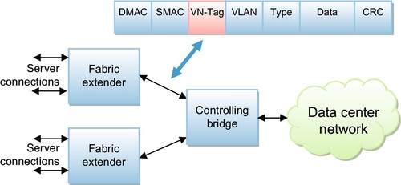
VN-TAGS
FIGURE 7.4 VN-Tag forwarding and frame format.

Slide 42
VN-TAGS
Some people may mistake the VN-Tag for a tunneling tag.
In a Cisco style network, the controlling bridge at the end of a row is the master of the fabric extenders that sit within the server racks.
The controlling bridge makes all of the VIF assignments and the NIC can use these tags to pass the frames to the correct VMs.

Slide 43
VN-TAGS
Because VN-tagging forms a frame that is not recognized by all different types of networking equipment, it is used locally within the controlling bridge domain and may need to be encapsulated further to pass it on through the data center network.
Although these VN-tags provide virtual networking features, they are used to identify VMs instead of tenants.
Because of this and other reasons, Cisco was a main contributor in the development of the VXLAN standard which will be described in the next section.

